Slide 1
An Overview for Predentals
2023-2024
Notes:
[Introduce the presentation and yourself.]
(For example, Thank you for joining us today to introduce you to ASDA and why membership in ASDA is an important step in getting connected to the field of dentistry. My name is xxxx. I’m a xxxx grad at xxxx. I first became involved in ASDA xxxxx. Let’s get started!]

Slide 2
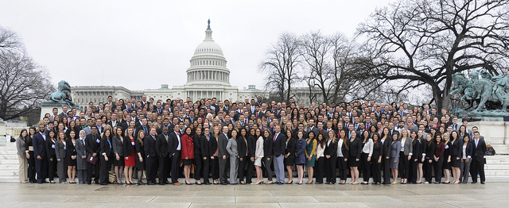
What is ASDA?
ASDA was founded in 1971 and has grown to be the largest national organization representing 22,000 dental and predental student members.
Notes:
ASDA was founded in 1971 by dental students. Since the 70’s, ASDA has grown to become the largest national organization representing dental students. ASDA has a chapter at every dental school in the US and Puerto Rico, as a well as a national office in Chicago. ASDA represents more than 22,000 members. Let’s take a closer look at how ASDA is organized.

Slide 3
ASDA’s Mission
The American Student Dental Association is a national student-run organization that protects and advances the rights, interests and welfare of dental students.
It introduces students to lifelong involvement in organized dentistry and provides services, information, education, representation and advocacy.
Notes:
ASDA member leaders at the national, district and local level help fulfill ASDA’s mission. What is a mission? A mission is an explanation of why an organization exists.
What is ASDA’s mission:
ASDA is a national student-run organization that protects and advances the rights, interests and welfare of dental students. It introduces students to lifelong involvement in organized dentistry and provides services, information, education, representation and advocacy.
Our mission guides what ASDA does, who we do it for and how we do it. For ASDA, that means we are a student-run organization that:
Protects dental students
Advances dental student rights/interests
Introduces organized dentistry
Provides information and education
Represents dental students
Advocates on their behalf

Slide 4
Notes:
Each dental school has an ASDA chapter. Each chapter has two representatives, also known as delegates, who vote during the House of Delegates. The House of Delegates votes on ASDA policy such as legislative policies, ASDA’s code of ethics, professional issues such as vaping, and more. The House also elects ASDA’s president, two vice presidents and Speaker of the House who are part of ASDA’s Executive Committee.
Chapters are grouped in one of ASDA’s 11 districts. The chapters of a district elect their ASDA District Trustee who sits on ASDA’s Board of Trustees.
ASDA’s Board of Trustees consists of the Executive Committee, the 11 district trustees, and the Immediate Past President. The Board appoints councils and the Executive Committee appoints board management committees.
To help support the House, Board and ASDA’s council and committees, ASDA has a national office in Chicago with staff members. Staff work in areas such as membership, social media, advocacy and education- all focused on ASDA’s members. This is similar in structure to the ADA. The ADA also has a House of Delegates, a Board of Trustees, national council and committees and staff located in Chicago.
Dental students are the focus of ASDA and help lead the organization. What guides ASDA’s member leaders?

Slide 5
What does ASDA do?
Notes:
ASDA’s mission sets the objectives of the organization and informs what ASDA does. As a result of ASDA’s mission, we:
Are a channel for member concerns including dental education, ethics, dental research, dental school financing
Provide learning and education to help members lead in practice and within organized dentistry
Support diversity and inclusion
Capture support of legislators and dental schools through grassroots initiatives identified by members
Provide a dental student and organized dentistry community
Keep members up-to-date on issues important to dental students
Common thread – ASDA’s mission is focused on dental students. Dental students, who are members, set the course in identifying concerns, policies, legislative objectives, etc. ASDA exists for its members and its members, you, guide ASDA. So, what does it mean to be a member of ASDA?

Slide 6
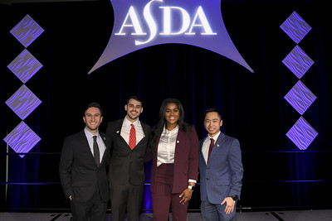
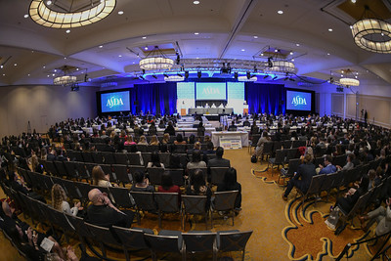
National ASDA – Membership Benefits
Notes:
As an ASDA member you belong to the largest organization of dental students. ASDA provides you benefits and services to help you succeed. These include: publications by and for dental students, networking with dental students across the country as well as current dentists, online education to introduce you to various career pathways, leadership development so you can lead in the operatory. ASDA introduces you to organized dentistry, and provides tons of opportunities to get involved. But that’s not all - ASDA advocates for you and provides you the tools to advocate, there are events and activities at the local, district and national level, resources on areas of concern including wellness, diversity and inclusion.
I know that was a lot of information! Let me share what ASDA means to me.
[include what ASDA membership means to you]
Now, let’s dive into some of these areas a little more.

Slide 7
What does Organized Dentistry mean?
Organized Dentistry
Combined efforts of all dental organizations
ASDA partners with:
American Dental Association (ADA)
Academy of General Dentistry (AGD)
American Dental Education Association (ADEA)
State dental societies and associations
Specialty societies and associations
Student dental groups
Notes:
Organized dentistry is a way to describe the combined efforts of all dental organizations (such as ASDA, ADA, state societies, etc.) that work together to positively contribute to the dental profession.
ASDA fosters the path toward a lifelong commitment to organized dentistry both at the chapter, district and national level. ASDA works with other organizations to represent the dental student voice and make change.
Examples of collaboration include working with AGD, other specialty organizations and with student dental groups like SNDA, SAID, HSDA, and ADEA Council of Students.

Slide 8
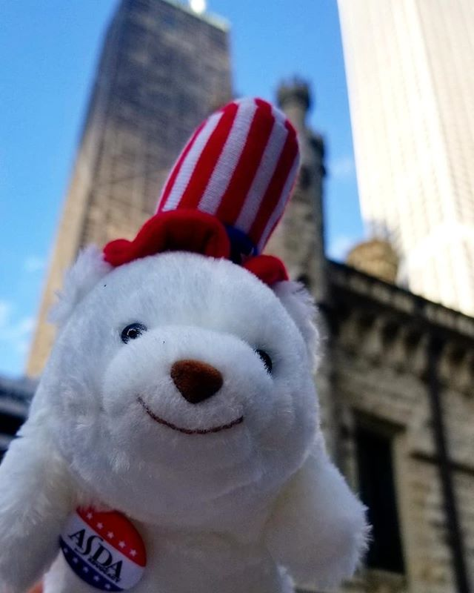
ASDA Advocates For You
Keeps you informed on issues impacting the dental profession
Represents your interests and provides opportunities to champion your rights as future dentists
Supports patients by advocating for the protection and advancement of their welfare within the profession
Notes:
Goals of ASDA advocacy:
Keep students informed – this is achieved through advocacy webinars and ASDA’s e-publication Advocacy Brief. Advocacy Brief shares updates on the state and federal level about issues that affect dental students, like licensure reform, midlevel providers, student debt, etc.
Provides opportunities to champion our rights and get involved– ASDA Action – send letters directly to lawmakers. Lobby Day students have the unique opportunity of meeting face-to-face with lawmakers and discussing issues important to dental students
Supports patients – support specific legislation to alleviate barriers to care and protect patients.

Slide 9
ASDA Action
What is it?
ASDA’s grassroots advocacy software where members can send letters to their legislators about issues that affect dental students.
You can sign up for text alerts to receive a text when we need your help.
Explore other ASDA Action features like looking up bills and candidates running for office.
Notes:
ASDA Action is your way to get involved with advocacy at the grassroots level. Grassroots advocacy means starting at the local level to affect change on a grander scale. It’s centered around the idea that people matter, your stories matter, and our voices are powerful in influencing elected officials at all levels. Some people may be hesitant or nervous to get involved with advocacy because they think they don’t know enough about the issues. ASDA Action makes it simple, quick, and easy to get involved.
Visit ASDAnet.org/ASDAAction to see the main portal. From here, you can explore ASDA Action’s various features like:
Sending letters to your legislators on issues that affect dental students
Signing up for text alerts to receive a text when we need you to take action
Looking up bills currently in Congress, and if ASDA has taken a position on them
Looking up who are your candidates running for office
And much more
We need our members and our voices to effect changes and advance the dental profession forward.

Slide 10
ASDA Leadership in Action
Notes:
Another key focus for ASDA is leadership development. As future dentists, you will be oral health leaders and ASDA is your path to gaining skills beyond those learned in dental school. Let’s take a look at just some of the options you can access as an ASDA member.

Slide 11
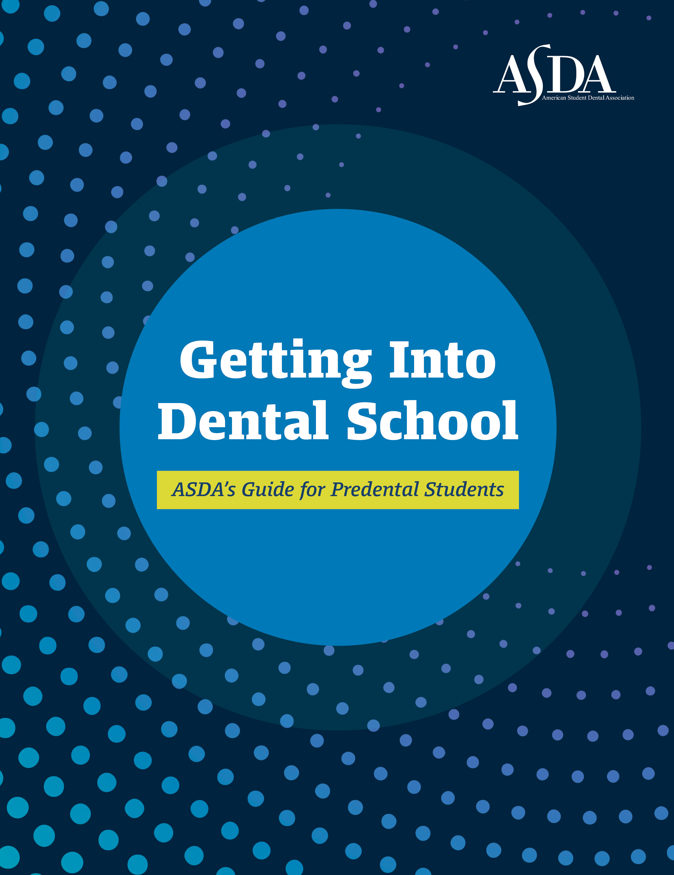
Getting into Dental School
ASDA’s Predental handbook Answers FAQs about:
The DAT
Interview tips
Networking as a predental
Includes listing of all U.S. dental schools and specific admission requirements
Notes:
As a predental member of ASDA, you will receive Getting into Dental School. This guide includes information on all US dental schools including tuition, average GPA, average DAT score and grading system. Plus, you’ll find information from current and recently graduated dental students who have been in your shoes.
This guide also provides predentals with helpful tips on seeking letters of evaluation, choosing a dental school, the different career paths within dentistry, taking a gap year, and so much more!
[Include more information if you are familiar with the Guide.]

Slide 12
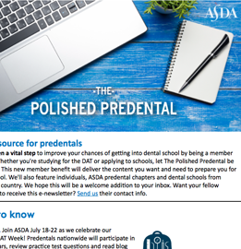
ASDA Publications
Publications that keep you updated on current issues in dentistry
Predental Timeline
Predental Shadowing Guide
How-To Guide Applying to Dental School for Non-Traditional Students
Notes:
As a predental member you will receive two publications: The Polished Predental and Contour. Polished Predental is an emailed newsletter and Contour is ASDA’s magazine you can access online. These publications keep you up-to-date on the field of dentistry. It is also a great resource to build your understanding of the dental field and issues important to dental students. Articles are written by experts in the field, current dental students, and recent graduates.
Additional guides and handbooks only available to ASDA Predental members include the Predental Timeline, Predental Shadowing Guide and the How-to Guide Applying to Dental School for Non-Traditional Students.

Slide 13
US Dental School and ASDA Chapter Info
Notes:
Providing information and resources is another key mission objective of ASDA. As a predental, ASDA is your resource for information on dental schools and ASDA’s predoctoral chapters. Go to ASDAnet.org to find a list of all US dental schools, links to the dental program online and a list of all predoctoral ASDA chapters. Remember, ASDA’s predoctoral chapters are grouped by district. The map of the US on the slide shows ASDA’s 11 districts in various colors.

Slide 14
Get Connected
Instagram
@dentalstudents and
[Add Chapter]
[Add District]
Facebook
[Add Chapter]
[Add District]
Notes:
Connect with national ASDA through social media. National ASDA’s Instagram is provided on this slide. Get connected to build your dental community.
ASDA Districts and Chapters also have instagram and facebook accounts that predentals can reach out to and follow. Additionally, some ASDA Districts may also have predental accounts as well.

Slide 15
Join Today!
Dues are $71/year
Join for membership through December 31, 2024.
Membership opened on September 6, 2023 for the 2024 year.
www.ASDAnet.org/join
Notes:
ASDA is an organization focused on dental students. And, we are able to achieve our mission through the support of our members. Join ASDA today!
[2024 membership year opened September 6, 2023.]

